Slide 1
Python Programming
Lesson 9

Slide 2
Topic
Graphical User Interface (GUI) using tkinter
  Planning
  Label
  Entry box
  Button

Slide 3
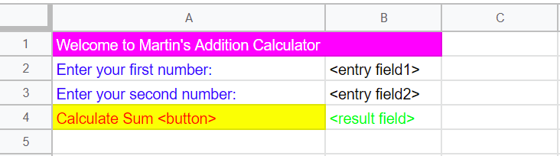
Planning your layout
In any GUI, you need to have an idea how it looks like
Below is a sample of how an addition calculator will look like and we will use it to model after our BMI Calculator:
Open a google sheet and plan how your BMI Calculator is going to look like

Slide 4
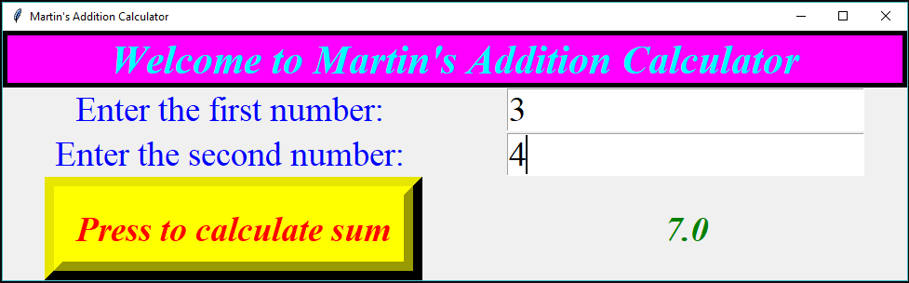
Expected outcome
Plan
Outcome
Notes:
Teachers can run the script add2num5.py to show the expected outcome.

Slide 5
The Label Widget
The Label widget is a standard tkinter widget used to display a text or image on the screen. The label can only display text in a single font, but the text may span more than one line.

Slide 6
The Entry Widget
The Entry widget is a standard Tkinter widget used to enter or display a single line of text. The entry widget is used to enter text strings. This widget allows the user to enter one line of text, in a single font.

Slide 7
The Button Widget
The Button widget is a standard tkinter widget used to implement various kinds of buttons. Buttons can contain text or images, and you can associate a Python function or method with each button. When the button is pressed, tkinter automatically calls that function or method.

Slide 8
Ex 1 – Which widget to use?
???
???
???
???
???

Slide 9
Ex 1 – Suggested Answers
label
label
entry
label
button

Slide 10
Understanding the position of the widgets
We realise that this GUI needs 7 widgets to work but how do we position them?
We use a column, row system
row = 1, column = 0
row = 0, column = 0
row = 1, column = 1

Slide 11
Ex 2 – Position of Widgets
What are the positions of the rest of the widgets?
row = 1, column = 0
row = 0, column = 0
???
row = 1, column = 1
???
???
???

Slide 12
Ex 2 – Suggested Answers
What are the positions of the rest of the widgets?
row = 1, column = 0
row = 0, column = 0
row = 2, column = 0
row = 1, column = 1
row = 2, column = 1
row = 3, column = 1
row = 3, column = 0

Slide 13
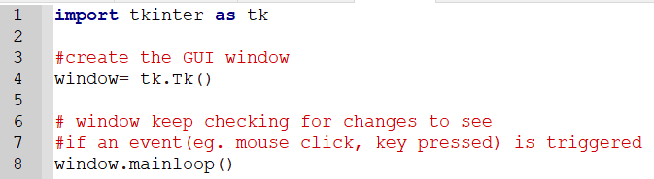
Creating the tkinter Application window
We first need to import the tkinter module. We name the application window, window (line 4)

Slide 14
Adding widgets to the window
The codes to all the widgets are given to you. Study the comments. Can you identify the lines of code that belong to each widget?

Slide 15
Match code with widget 1
This code will create the widget at cell ???

Slide 16
Match code with widget 1a
This code will create the widget at cell A2

Slide 17

Match code with widget 2
This code will create the widget at cell ???

Slide 18
Match code with widget 2a
This code will create the widget at cell B3

Slide 19
Match code with widget 3
This code will create the widget at cell ???

Slide 20
Match code with widget 3a
This code will create the widget at cell A4
Calls the display_sum function when the button is pressed

Slide 21
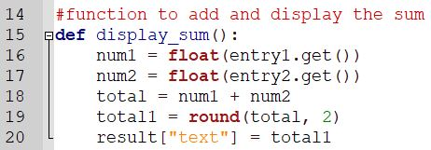
display_sum()
Do you know what the function does when called?
Notes:
Notes:
The function will get the 2 numbers from the entry boxes, convert them to float and sum them. The answer is then rounded to 2 decimal places and displayed in the label called result.

Slide 22
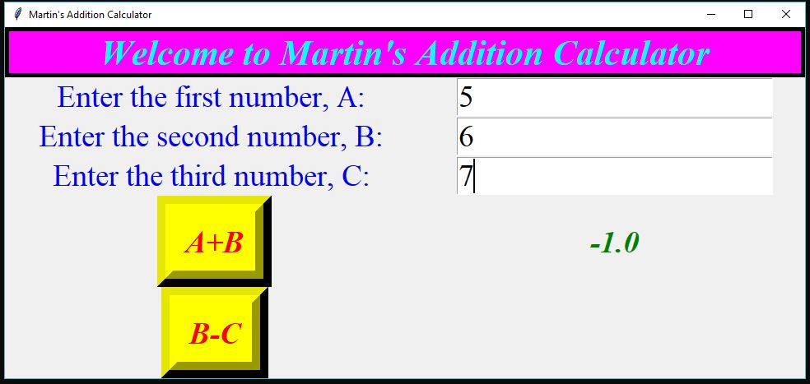
Ex 3 – Adding a label, entry and button widget
Let’s modify and add to the codes to make a working GUI as shown
Notes:
Teachers can run the script addsub.py to show students what is the expected outcome.

Slide 23

Ex 3 – Suggested Answers 1
Let’s modify and add to the codes to make a working GUI as shown

Slide 24
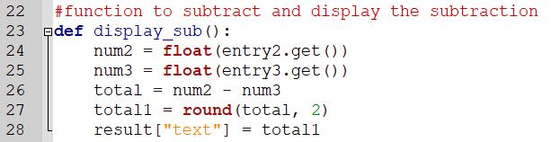
Ex 3 – Suggested Answers 2
Let’s modify and add to the codes to make a working GUI as shown

Slide 25
GUI for BMI Calculator Challenge
Can you now code the GUI of the BMI calculator you have designed at the beginning of the lesson?

Slide 26
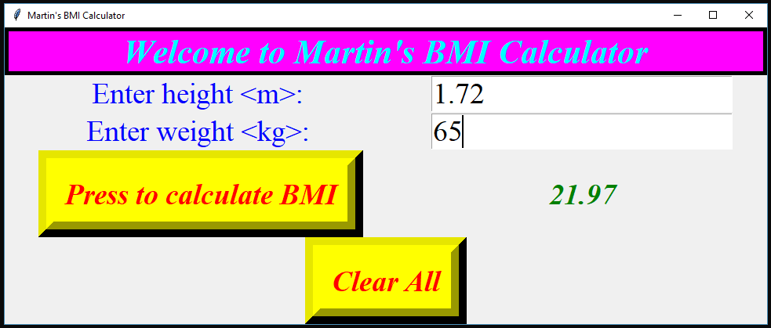
Sample GUI for BMI Calculator
Notes:
Notes: Clear All button is optional
Teacher should run the given program to show the students how it works. bmi_gui3.py

Slide 27
GUI for Guess the Number Game Challenge
Can you now design and code the GUI for the Guess the Number Game?

Slide 28
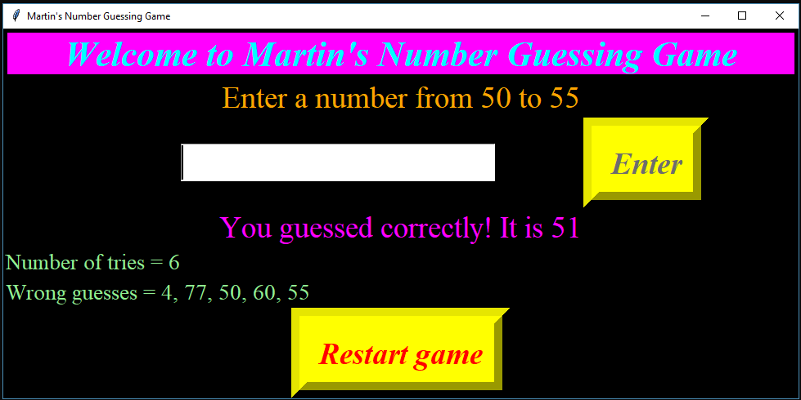
Sample GUI for Guess the Number Game
Notes:
Notes:
Teacher should run the script guess_gui4.py to show the students how it works. There are a few new codes that are not taught. Students are encouraged to go online and search for solution.

Slide 29
Additional Information
To learn more widgets in the tkinter module, go to https://www.tutorialspoint.com/python/python_gui_programming.htm

Slide 30
End of Lesson 9

